Slide 1

Welcome!!
To Modern Endpoint Management Summit 2022

Slide 2


Nicklas Ahlberg
Damien Van Robaeys
MVP- Enterprise Mobility
Consultant Modern Workplace
Intune + PowerShell + MS Graph

Slide 3
Microsoft Graph, PowerShell, Intune

Slide 4
Microsoft Graph, PowerShell and Intune
Repetitive task on a daily basis
Automate with PowerShell and Microsoft Graph
Work smarter, not harder!

Slide 5
Smarter…
Apply it once
Create script
Apply the configuration to make sure it works as intended
Add the config to a script
Manual, Test, Automate, Reuse
Set it up manually
Reuse
Add configuration manually as the first step
Next time you need to do the same task again, just run the script

Slide 6
Endpoints
Use the v1.0 endpoint when possible
Microsoft Graph v1.0
All API sets are in general availability status
Upcoming API updates should not break existing apps
Microsoft Graph BETA
Preview
Should not be used in production scenarios as upcoming updates could break your current app logic
This endpoint includes much more info

Slide 7



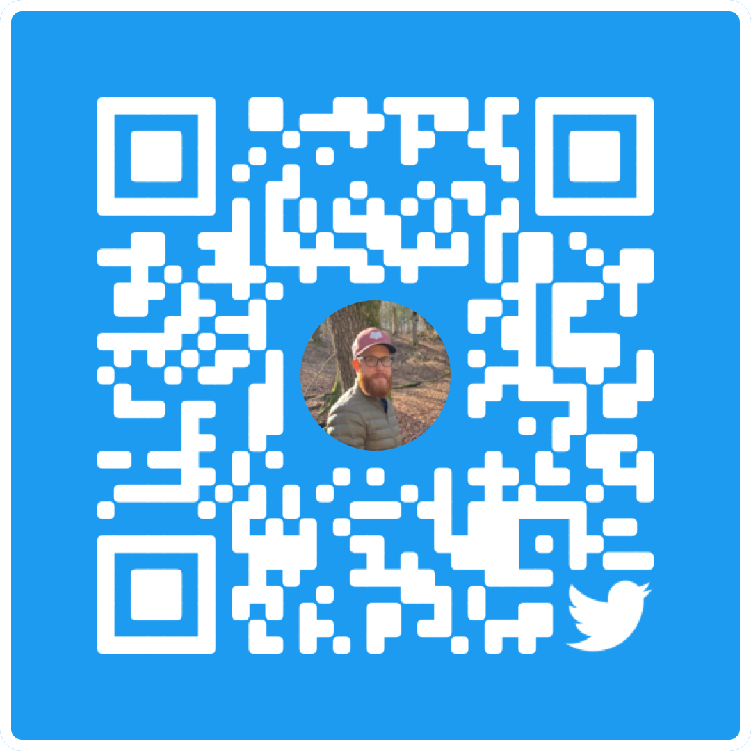
Senior System Engineer at Cygate
Microsoft MVP x 1
nicklasahlberg.se (Rock Enroll)
@AhlbergNicklas
Nicklas Ahlberg
linkedin.com/in/nicklasahlberg

Slide 8
Endpoint
### Get encryption status from MEM
$parameters = @{
"apiURL" = "https://graph.microsoft.com/beta/deviceManagement/managedDeviceEncryptionStates"
"method" = "Get"
}
$Data = Invoke-RestMethod -Headers @{ Authorization = "Bearer $($token)" } -Uri $parameters.apiURL -Method $parameters.method
$Device = ($Data | select-object Value).Value | Where-Object { $_.DeviceName -eq $deviceNameTb.Text }
$encryptionStatus = $Device | Select-Object -Property deviceName, encryptionstate, tpmSpecificationVersion

Slide 9
Unauthorized vs Forbidden
Invoke-RestMethod : The remote server returned an error: (401) Unauthorized.
Successfully authorized but the app does not have sufficient permissions
Invalid access token
Invoke-RestMethod : The remote server returned an error: (403) Forbidden.

Slide 10
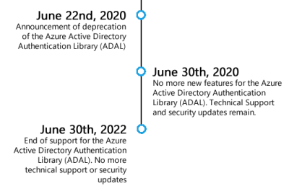

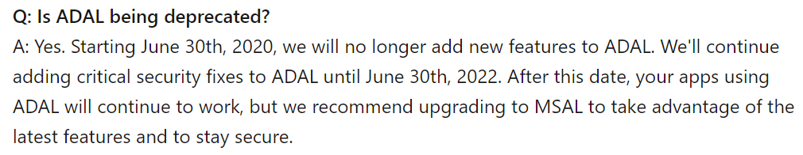
Microsoft Authentication Library (MSAL)
Acquire tokens to gain secure access to Microsoft Graph!
Acquire a token and authenticate to MS Graph
The token is attached as a bearer to the auth header in an HTTP request
Get it from the PowerShell Gallery: Install-Module MSAL.PS
Cmdlet to acquire token: Get-MSALToken
Cmdlet to HTTP request: Invoke-RestMethod -Header

Slide 11
MSAL: Get access token
PowerShell script
$connectionDetails = @{
'TenantID' = 'yourTenantID'
'ClientID' = 'yourClientID'
}
$MSALToken = Get-MsalToken @connectionDetails
$MSALToken.AccessToken
$connectionDetails = @{
'TenantID' = 'yourTenantID'
'ClientID' = 'yourClientID'
}
$MSALToken = Get-MsalToken -clientID $connectionDetails.ClientID -tenantID $connectionDetails.TenantID
$MSALToken.AccessToken

Slide 12
Use PowerShell to acquire access token
Demo

Slide 13
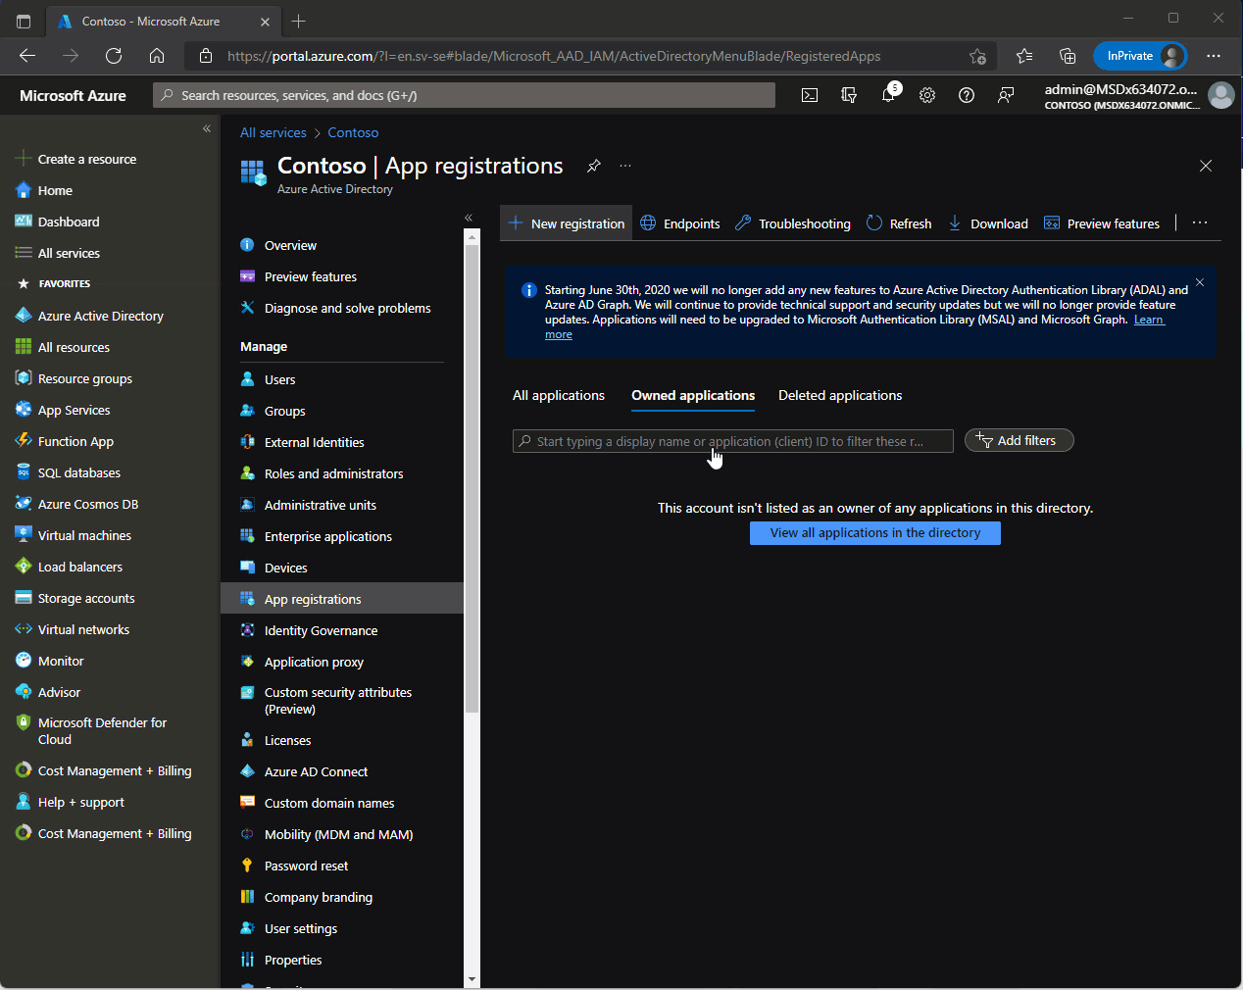
Get MSAL access token
Delegated permissions
Now we have our access token! 😃

Slide 14
MEM Portal, GE and PS
Demo

Slide 15
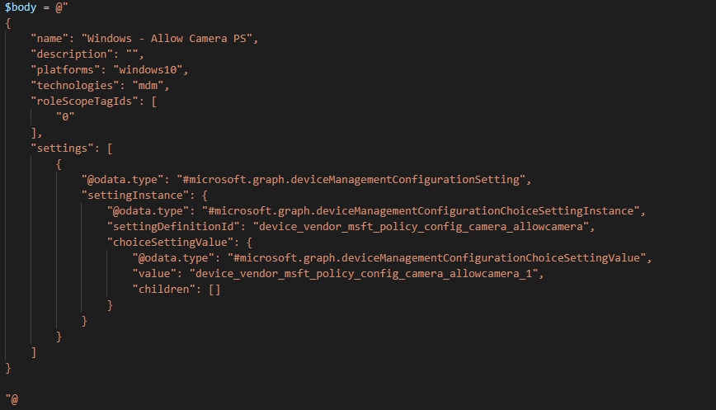
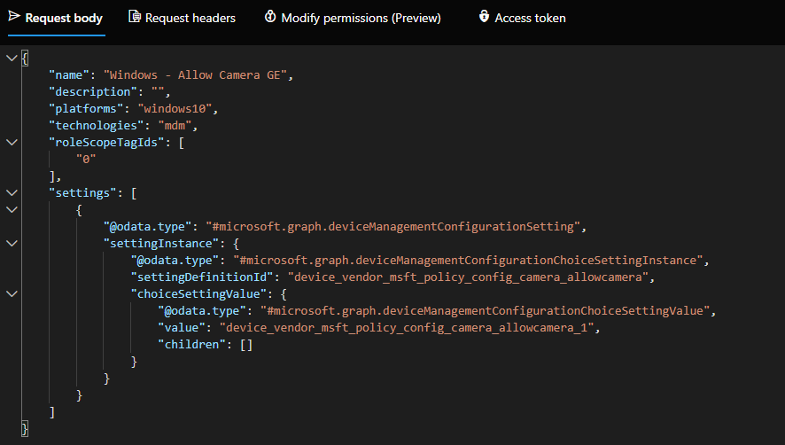
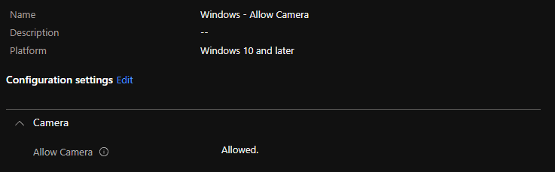
Portal/GE/PowerShell

Slide 16
Azure Key Vault and MS Graph
Acquire tokens to gain secure access to Microsoft Graph!
Install-Module AZ.KeyVault.PS & Install-Module AZ.Account.PS
Get-MSALToken
Invoke-RestMethod -Header
Connect-AZAccount
Get-AzKeyVaultSecret -VaultName ’yourKeyVault' -Name ’yourSecret'
Remember: Never reveal the secret in clear text!

Slide 17
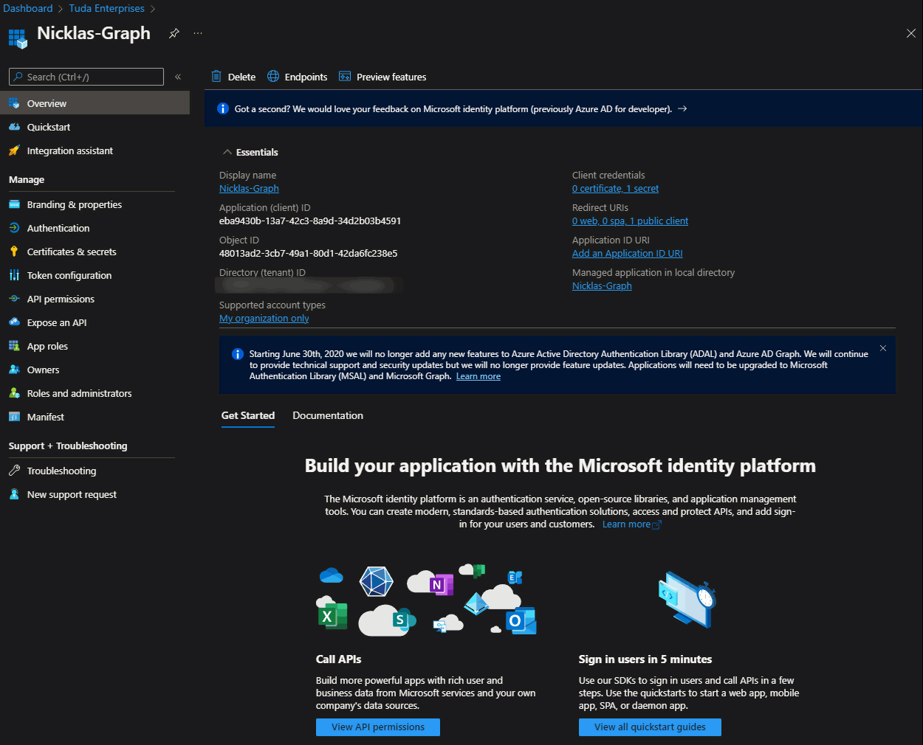
Azure KeyVault Secret gif

Slide 18

Microsoft Graph, PowerShell,
Intune
Repetitive tasks
Users, policies, reports etc..
01
Work smarter, not harder
02
Manual, test, automate, reuse
Have fun!
03
Be creative and (slightly) crazy ;-)

Slide 19
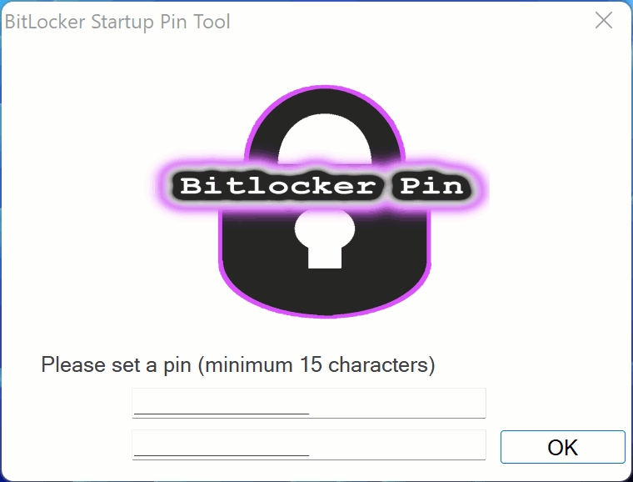
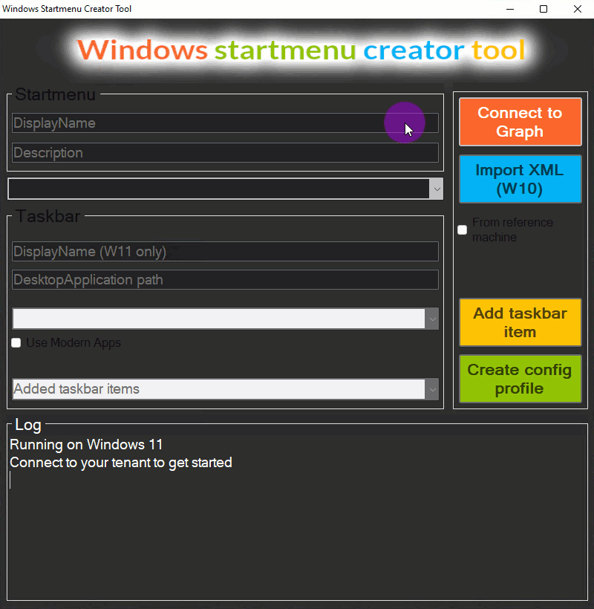
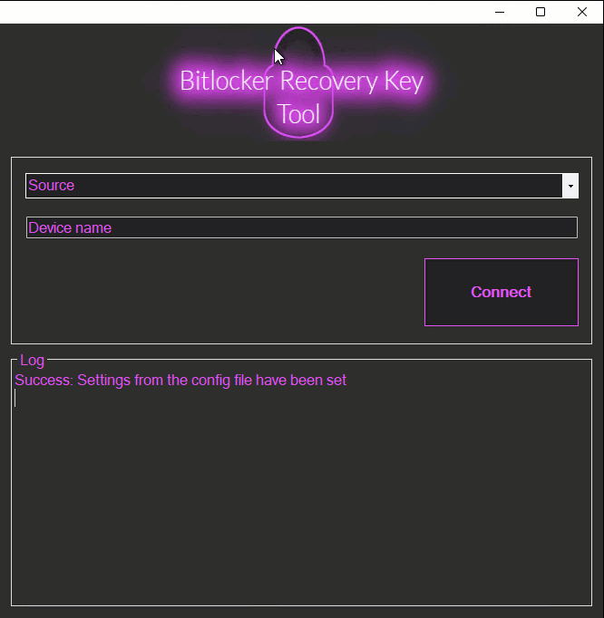
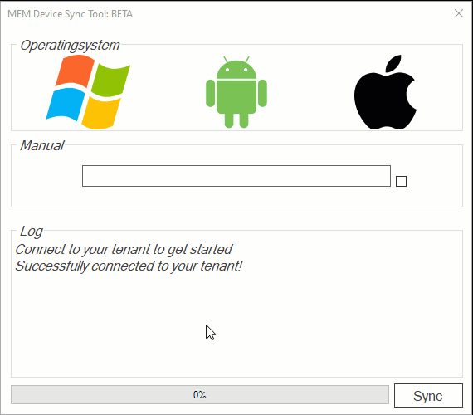
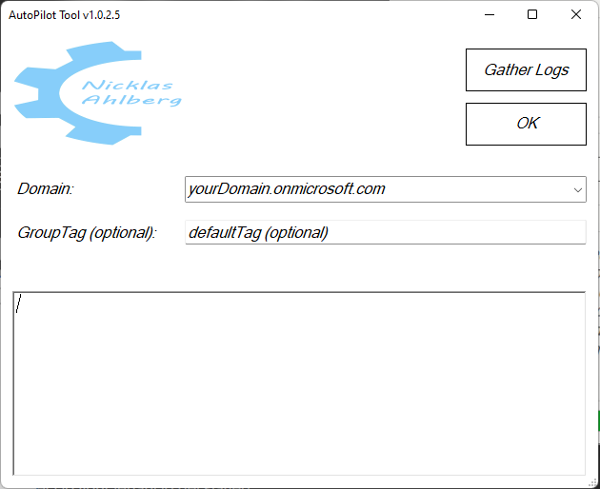
Have fun!

Slide 20
Thank you!!
To all our sponsors

